Slide 1

Kaff Platform
Group 3
Jumana, Sumaiyah, Mariam, Zaina, Duaa, and Latifa

Slide 2
What is Kaff Platform?

Slide 3
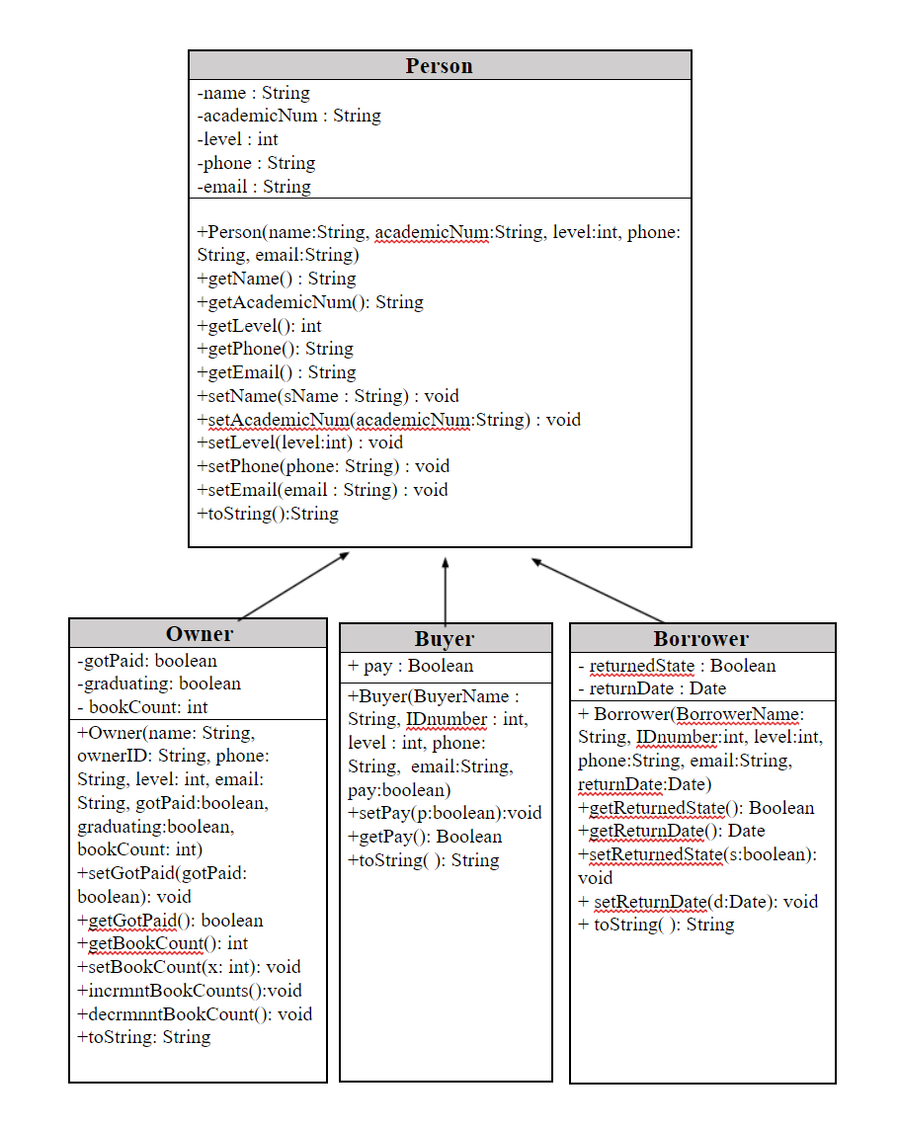
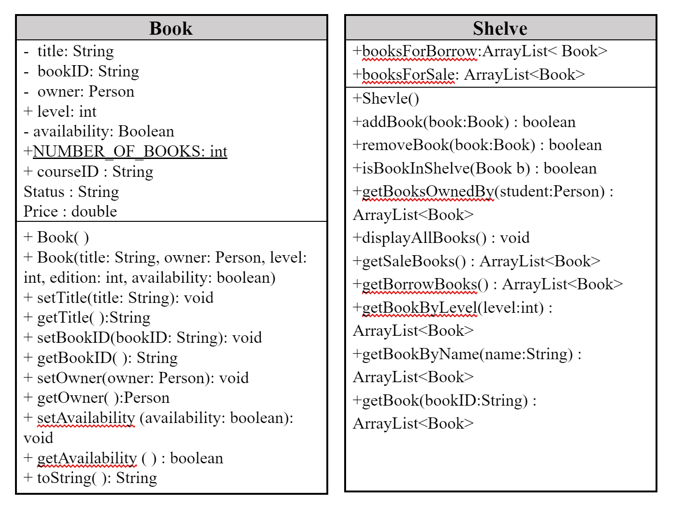
UML

Slide 4
Methods in the main - Jumana’s Part

Slide 5
Methods in the main - Doaa’s Part :
case 2: {
// 2- buy book
Book book = getTheBook();
if (book != null) {
System.out.println("The book price is: " + book.getPrice());
// checks if the user is a buyer or create a buyer object
if (!flagBuyer)
for (int i = 0; i < getBuyers(user).size(); i++)
if (((getBuyers(user)).get(i).getAcademicNum()).equals(userId)) { flagBuyer = true;
break; }
if (!flagBuyer) {
user.add(new Buyer(name, userId, userLvl, phone, email, true));
currentBuyer = (user.size()) - 1; }
// book is bought..
book.setAvailability(false);
System.out.print(book + "\nYou have bought this book.");
balance += book.getPrice(); }
line();
break; }
Case 2 (buy book):

Slide 6
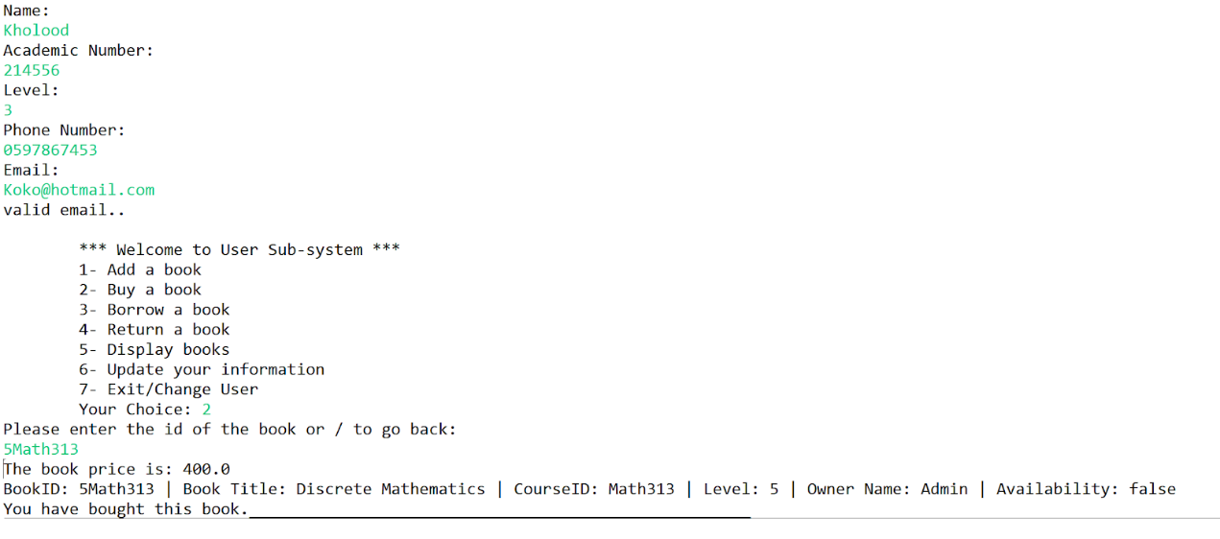

Slide 7
Case 3 ( borrow book ):
if (!flagBorrower) {
for (int i = 0; i < getBorrowers(user).size(); i++)
if (((getBorrowers(user)).get(i).getAcademicNum()).equals(userId))
flagBorrower = true;
}
if (!flagBorrower) {
user.add(new Borrower(name, userId, userLvl, phone, email, new Date()));
currentOwner = (user.size()) - 1;
}
// ask which book he wants to borrow
book = getTheBook();
if (book != null) {
if (book.getAvailability())
System.out.println(book + " is avaiable to borrow.");
else
System.out.println(book + " is not avaiable..");
book.setAvailability(false);
}}

Slide 8
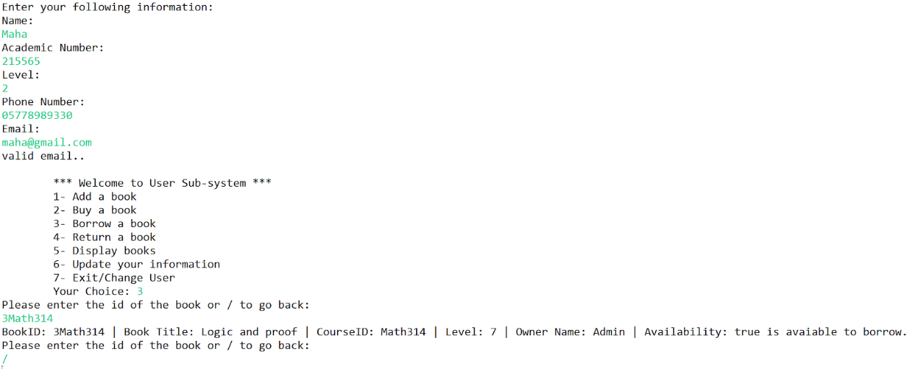

Slide 9
Case 4 ( return a book ):
case 4: {
book = getTheBook();
if (book != null) {
System.out.println("Thank you for returning the book.");
book.setAvailability(true);
}
break;

Slide 10
Asks user for the book id and returns the book:
static public Book getTheBook() {
Book book = null;
do {
System.out.println("Please enter the id of the book or / to go back:");
String bookID = input.next();
if (bookID.equals("/"))
break;
book = shelve.getBook(bookID);
if (book == null)
System.out.println("The book ID is not available.");
} while (book == null);
return book;
}

Slide 11
Get Book:
public Book getBook(String bookID){
//look in booksForBorrow
for(int i = 0; i < booksForBorrow.size(); i++){
if(bookID.equalsIgnoreCase(booksForBorrow.get(i).getBookID()))
return booksForBorrow.get(i);
}
for(int i = 0; i < booksForSale.size(); i++){
if(bookID.equalsIgnoreCase(booksForSale.get(i).getBookID()))
return booksForSale.get(i);
}
return null;
}

Slide 12
Got Buyer:
static public ArrayList<Buyer> getBuyers(ArrayList<Person> user) {
ArrayList<Buyer> buyer = new ArrayList<>();
for (int i = 0; i < user.size(); i++)
if (user.get(i) instanceof Buyer)
buyer.add((Buyer) user.get(i));
return buyer;}
Got Borrwer:
static public ArrayList<Borrower> getBorrowers(ArrayList<Person> user) {
ArrayList<Borrower> borrower = new ArrayList<>();
for (int i = 0; i < user.size(); i++)
if (user.get(i) instanceof Borrower)
borrower.add((Borrower) user.get(i));
return borrower; }

Slide 14
Methods in the main - Zainah’s Part :
case 5: {
//Display books
line();
System.out.println("What do you want to do? \n" + "\t1- Display all books. \n"
+ "\t2- Display books for sale. \n" + "\t3- Display books for borrowing. \n"
+ "\t4- Display books by level. \n" + "\t5- Display books by title. \n");
int c = input.nextInt();
switch (c) {
case 1:
shelve.displayAllBooks();
break;
case 2:
printList(shelve.getBooksForSale());
break;
case 3:
printList(shelve.getBooksForBorrow());
break;
case 4:
System.out.print("Choose the level from 1 to 10:");
int level = input.nextInt();
printList(shelve.getBooksByLevel(level));
break;
case 5:
System.out.print("Enter the book title:");
String title = input.nextLine();
title = input.nextLine();
printList(shelve.getBooksByName(title));
break;
default:
System.out.println("Invalid entry.");
line();
}
break; }

Slide 15
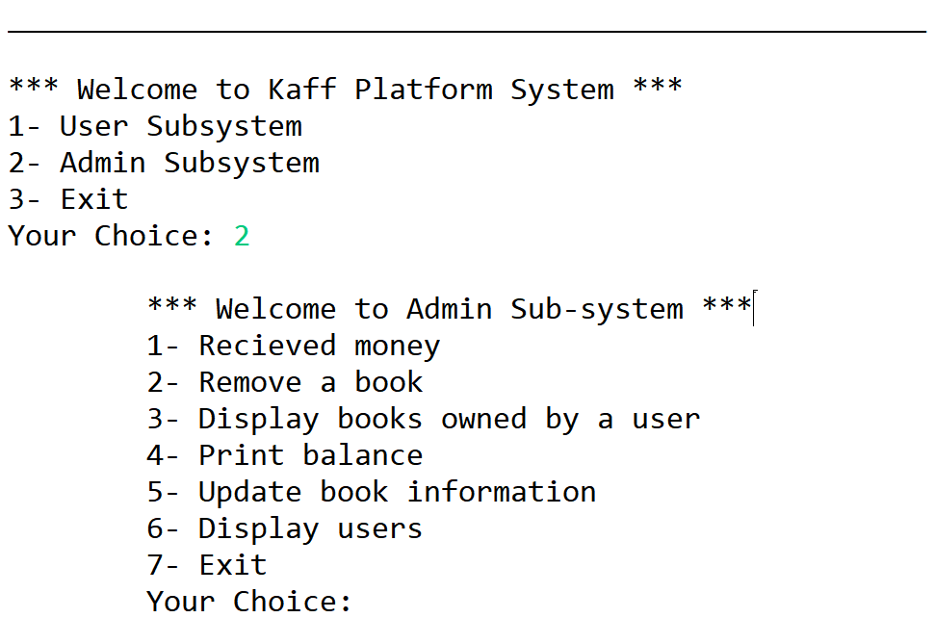
Methods in the main - Latifa’s Part :
Static void admin_system() {
int choice;
do {
System.out.print(admin_menu);
choice = input.nextInt();
ه

Slide 16
Case 1 : Received money
// Received money
System.out.print("Enter the owner ID:");
String ownerId = input.next();
boolean flag = false;
for (int i = 0; i < getOwners(user).size(); i++)
if (((getOwners(user)).get(i).getAcademicNum()).equals(ownerId)) {
(getOwners(user)).get(i).setGotPaid(true);
System.out.print(getOwners(user).get(i).getName() + " has received her money.");
flag = true;ه
break; }
if (!flag) {
System.out.print("Invalid Academic Number.");
break;

Slide 17
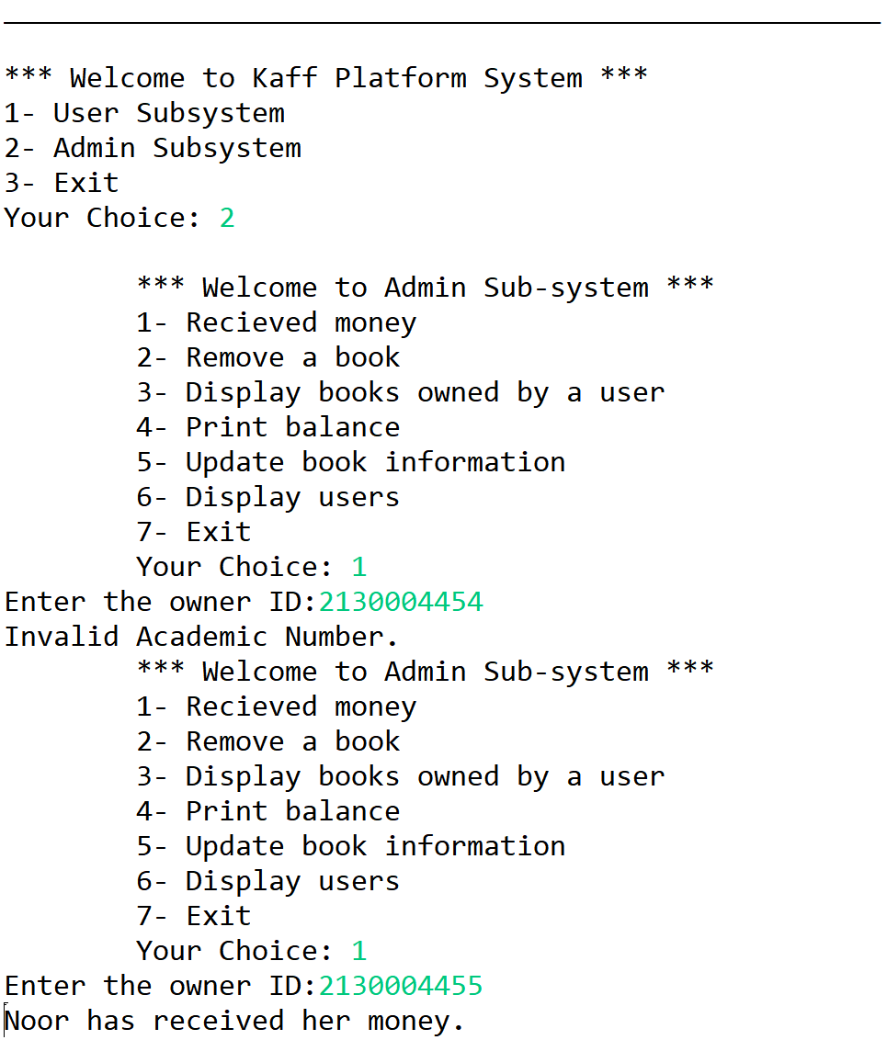

Slide 18
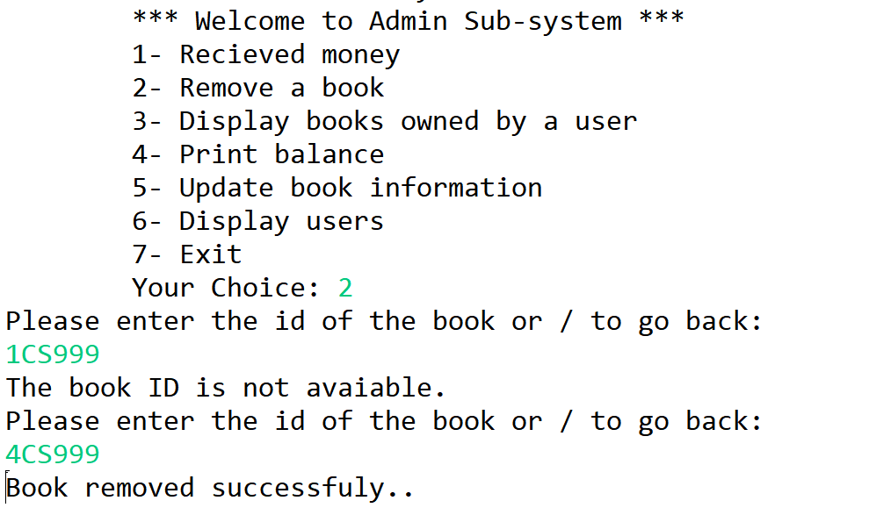
Case 2: Remove book
// reremove book
Book book = getTheBook();
if (book != null && shelve.removeBook(book))
System.out.println("Book removed successfuly..");
else
System.out.println
("Ops.. Some error maybe wrong bookID entered.");

Slide 19
Case 3: Display book owned by user
// display book owned by user
System.out.println("Please enter user academic id number: ");
String id = input.next();
Person p;
if (isIDInList(id)) {
p = getUser(id);
if (p instanceof Owner)
printList(shelve.getBooksOwnedBy(p));
} else
System.out.println("Invalid ID number...:(");
break;

Slide 20
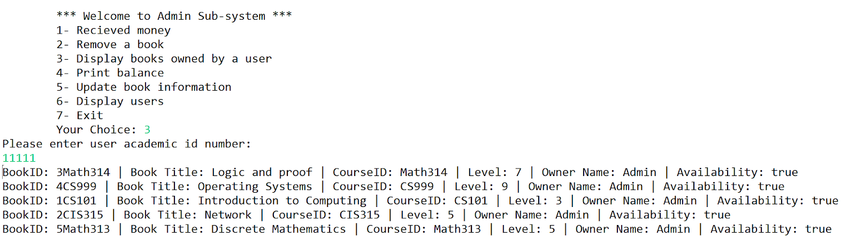

Slide 21
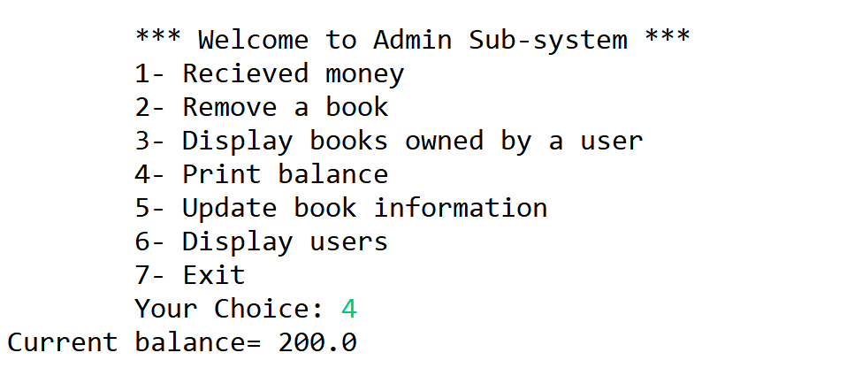
Case 4: Display the current balance
Case 4:
System.out.println("Current balance= " + balance);
break;

